Slide 1
Scramble for Africa
DBQ Writing Workshop

Slide 2
DBQ Essay
Will be part of the second session of the testing period.
In total, the second session will be 100 minutes, but you should allocate only 60 minutes (including reading period) for the writing of the DBQ.
The DBQ is 25% of the total AP Test grade.
The DBQ is scored out of 7 total possible points.
There will always be 7 documents, at least one of which will be a visual.
Students are required to bring in additional evidence from outside of the documents.
Nothing can get you multiple points! No double dipping! No double jeopardy!

Slide 3
DBQ Essay Rubric
Contextualization- 1 point
Response must relate the topic of the prompt to broader historical events, developments, or processes that occur before, during, or continue after the time frame of the question.
Thesis- 1 point
Responds to the prompt with a historically defensible thesis/claim that establishes a line of reasoning. It may not simply restate or rephrase the prompt.
Evidence- 3 points
Evidence from the Documents: 2 points
1 point: Uses the content from at least three documents to address the topic of the prompt
2 points: Supports an argument in response to the prompt using at least six documents
Evidence beyond the documents: 1 point
Uses at least one additional piece of specific historical evidence (beyond that found in the documents) relevant to an argument about the prompt.
Analysis and Reasoning: 2 points
Sourcing: 1 point
For at least three documents, explains how or why the document’s POV, purpose, historical situation, and/or audience is relevant to an argument.
Complex Analysis: 1 point
Demonstrates a complex understanding of the historical development that is the focus of the prompt, using evidence to corroborate, qualify, or modify an argument that addresses the question.
To earn the 2nd point, the response must demonstrate a complex understanding. This can be accomplished in a variety of ways:
Explaining nuance of an issue by analyzing multiple variables
Explaining both similarity & difference, or both continuity & change, or multiple causes, or both cause & effect
Explaining relevant and insightful connections within and across time periods
Confirming validity of an argument by corroborating multiple perspectives across themes
Qualifying or modifying an argument by considering diverse or alternative views or evidence

Slide 4
DBQ Essay Outline
Introduction Paragraph
Contextualization- situate your argument in a boarder historical context
THESIS- specifically answer ALL PARTS of the question with a historically defensible claim that includes a line of reasoning
Main Body Paragraphs (at least 2-3)
Topic sentence linking to your thesis describing contradiction, corroboration, and/or qualification of evidence (documents)
Following sentences use documents, source at least 3 docs, and provide one piece of outside evidence all in support of proving your argument
Concluding Paragraph
1st sentence: Restate the thesis (DON’T REPEAT, RESTATE)
2nd sentence: Extend the argument (what was the significance of these events in a wider context?)
3rd sentence: Link to similar historical issue/development (in earlier or later period), explain how it linked- SYNTHESIS

Slide 5
Let’s Practice!
We will follow these steps to work through our DBQ.
Analyze the prompt – ATQ!!!!
Read, analyze, and “group” the documents
Write the thesis/introduction
Write the body paragraphs – prove your thesis/argument!
Write the conclusion

Slide 6
Step 1) Analyze the Prompt
Evaluate the extent to which the responses to the European Scramble for Africa differed amongst Africans
What is the question asking you to do?

Slide 7
Step 2) Read, analyze/source and “group” the documents
At your table read and analyze the documents.
As a group you need to decide how the document discusses the differences in the African responses to European imperialism.
You also need to source the document: identify and explain how the author’s point of view or purpose, intended audience, and/or the doc’s historical context influences the interpretation or meaning of the document in its relevance in proving its connection to the cause or response.

Slide 8
Sourcing the Documents
Sourcing the Documents: In the DBQ Essay you will be required to “source” the documents. Sourcing the documents explains the significance of the author’s point of view, author’s purpose, historical context, and/or audience for at least THREE documents.

Slide 9
Sourcing the Documents makes you HAPPY
H= Historical Situation: How do contemporaneous developments (not described in the document) shape or inform the content of the document? Use context to situate the document.
A= Audience: Who is the document intended for?
P= Purpose: Why is the author writing this? How is the audience supposed to feel?
P= POV: on the next slide
Y= Wh(Y): on the next slide

Slide 10
Sourcing the Documents
Point of View (POV): Where is the author coming from? What is his/her background? AND WHY DOES HIS/HER BACKGROUND MATTER IN TERMS OF THE CREATION OF THE DOCUMENT?
Why: Why is this document significant? How does it relate to the prompt/discussion/time period?

Slide 11
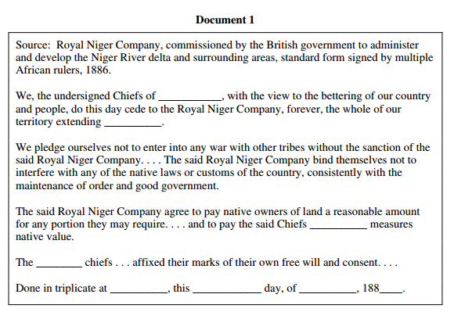
Document 1

Slide 12
Document 2

Slide 13
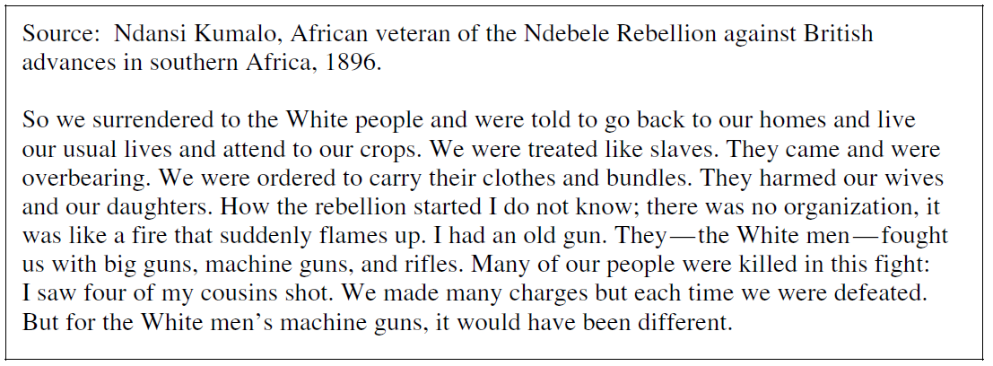
Document 3

Slide 14
Document 4

Slide 15
Document 5

Slide 16
Document 6

Slide 17
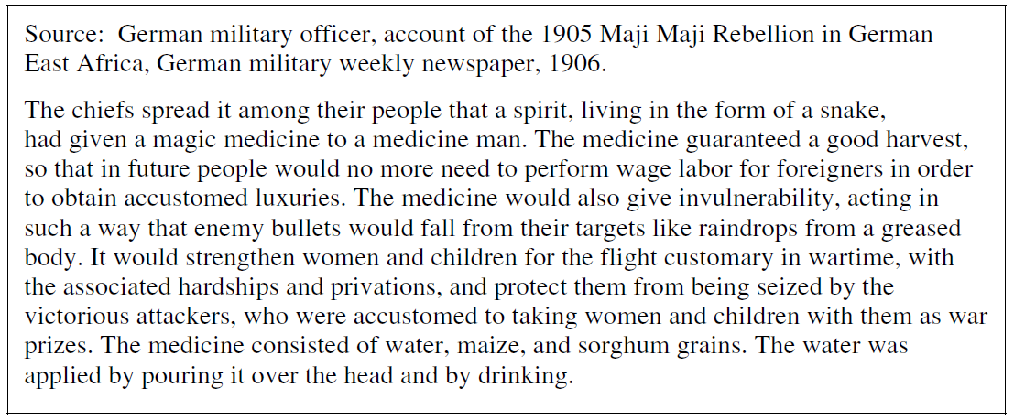
Document 7

Slide 18
Step 3) Share-Out
Organize your documents onto the T-chart – class needs to synthesize the causes and responses to a reasonable number (at least 2- 3).
After we have the documents “grouped” each group should explain their document’s sourcing.
Violent Resistance | Nonviolent/Call for resistance | Resort to tradition or past ways | Diplomacy/Work with Europeans | Accommodation to European demands
3, 4, 6, 7 | 5, 6, 7 | 2, 4, 5 | 1, 2, 3 | 1, 3, 5, 6

Slide 19
Step 4) Write the Thesis/Introduction
Suggestions for first sentence? (Broad context/time period)
Suggestions for second sentence? (explain the immediate backdrop for your essay)
Thesis: put the groups together to make an argument that ANSWERS THE QUESTION.

Slide 20
Contextualization
Motives of European imperialism
Industrial Revolution
Berlin conference

Slide 21
Thesis and Argument Development
Examples of acceptable theses:
A basic thesis:
There was a wide range of actions and reactions to the Scramble for Africa from the Africans themselves, from giving in peacefully to fighting back with all of their might.
Advanced thesis:

Slide 22
Step 5) Write the Body Paragraphs
This step has four parts:
The Topic Sentence which links the “group” to the thesis and explains the cause or response.
Use the documents to support/prove the contributing factors of the global silver trade and its relation to the argument.
Sourcing of at least 3 of the documents.
Introduction of outside information/evidence that helps support/prove the thesis/argument.

Slide 23
Step 5) Write the Body Paragraphs
Topic Sentence 1:
Topic Sentence 2:
Topic Sentence 3:
We will not divide back into our groups to work on the originally assigned document. Each group should writ a couple of sentences utilizing the document as evidence and sourcing the document. Each group should also write one sentence that introduces one piece of outside evidence.

Slide 24
Evidence Beyond the Documents
Example of providing an example or additional piece of specific evidence beyond those found in the documents to support or qualify the argument:

Slide 25
Step 6) Share-Out: Let’s put them together!
[put in 1st TS]
[groups put in sentences they wrote that go with this group]
[put in 2nd TS]
[groups put in sentences they wrote that go with this group]
[put in 3rd TS]
[groups put in sentences they wrote that go with this group]

Slide 26
Step 7) Write the Conclusion
1st sentence: Suggestions for restatement of the thesis?
2nd sentence: Suggestions for extension of the argument?
3rd sentence: Suggestions for contextualization?

